Slide 1
Missing Data
Module 02
Data Science Developer

Slide 2
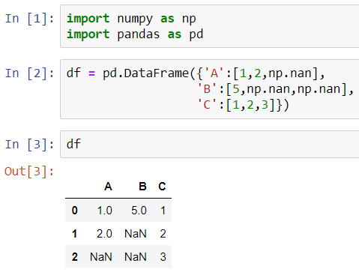
Create DataFrame with NaN Values

Slide 3
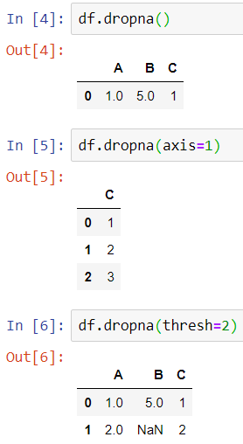
Dropna() method

Slide 4
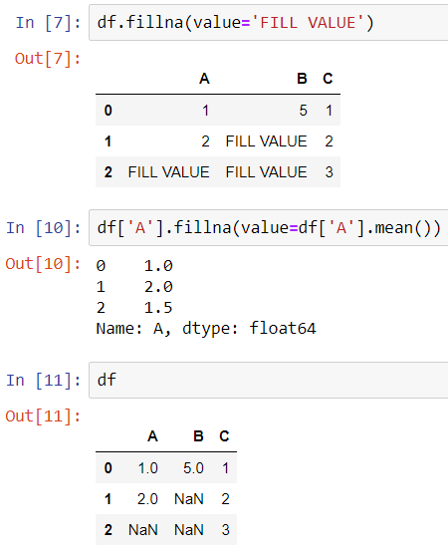
Fillna() method

